Slide 1

VNC Tracking System
<Release Number(s)>
Project Plan
Plan to Analyze <date>
Analyze to Design <date>
Design to Build <date>
Build to Test <date>
Test to Deploy <date>

Slide 2
Contents
Project Plan Sign-Offs
Project Description
Project Objectives
Measures of Success
Project Scope
Project Out of Scope
Project Assumptions
Project Team Structure
Risk Mitigation Plan
Change Control Process
Project Impacts
Project Tracking
Project Schedule

Slide 3
Project Plan Sign-Offs
Plan Stage
Walk-Through | Held On: | Document Version:
Decision | Accept as –is Revise – No further Walk-Through required Revise and schedule another Walk-Through
Role | Name of Attendee filling role at Walk-Through | Sign-Off (Content Review and Approval) | Date
Architect | Christopher Rhodes
Business Lead
Business Sponsor | VNC
Development Lead
Development Manager | Christopher Rhodes
Program Manager
Program Sponsor
Project Manager
Release Manager

Slide 4
Analyze Stage
Walk-Through | Held On: | Document Version:
Decision | Accept as –is Revise – No further Walk-Through required Revise and schedule another Walk-Through
Role | Name of Attendee filling role at Walk-Through | Sign-Off (Content Review and Approval) | Date
Architect
Business Lead
Business Sponsor
Development Lead
Development Manager
Program Manager
Program Sponsor
Project Manager
Release Manager

Slide 5
Design Stage
Walk-Through | Held On: | Document Version:
Decision | Accept as –is Revise – No further Walk-Through required Revise and schedule another Walk-Through
Role | Name of Attendee filling role at Walk-Through | Sign-Off (Content Review and Approval) | Date
Architect
Business Lead
Business Sponsor
Development Lead
Development Manager
Program Manager
Program Sponsor
Project Manager
Release Manager

Slide 6
Project Description
Implement a System to track certain things we own, provide information about those things and what we do with them to us and the extended VNC family.
<The project description should be a stand alone statement of what this project will accomplish and for whom. Make sure the description is very specific and concrete. Try to limit it to one sentence. Try to get it right because this description should not change, and you will be able to point to it throughout the project to remind them of the focus of the project. Use verbs in your description. Describe the project in a way that anyone could read your description and know what the project is without having to read other text.>

Slide 7
Project Objectives
<Project objectives address “why” you are doing this project. What are we trying to accomplish? What do we want the impacted area to look like afterwards or what do we want them to be able to do? Think of business benefits when completing this section. These are business objectives, not project process or methodology objectives (I.e., “develop specifications” is not a project objective) If you have more than a dozen or so, consider consolidating them or organizing them into two levels of bullets>
<Objective 1>
<Objective 2>
Measures of Success
<Measures of success are developed with the sponsor to determine at the end of a project how we will know whether or not we were successful. How should my environment change at the end of the project? These measures are very important to determine in advance so there is no misunderstanding about how the project will be measured once it has concluded.>
<Measure 1>
<Measure 2>

Slide 8
Project Scope
Web access to browse, add, update, delete things.
<Scope tells what your project is going to accomplish and sets the boundaries for your project. What are the sponsor and the business going to get at the end of your project? This goes to the very reason for doing the project. Create a bulleted list of deliverables. Each item on the list should begin with an action verb. For example:>
  <Select and install packaged software to provide client services a tool for automated tracking of in-force producer service requests>
  <Develop and implement interfaces between automated service request tracking solution and IPD workflow>
  <Develop and conduct training for client service personnel on use of automated tracking system and on use of interface to IPD workflow>
<If there are a lot of scope items, organize them into two levels of bullets with the first bullet being more like a category of deliverables (still with a verb in it!), and the sub-bullets being the deliverables>
<Scope item 1>
<Scope item 2>

Slide 9
Project Out of Scope
PDA/Wireless access to system
Contact management system – Use Outlook
As tempting as it is, there is no need to recreate a contact tracking system. Outlook is perfectly good at this. As such this system does not need to keep (much) information about addresses or phone numbers or other things associated with people, businesses, or other entities. The only time details would exist in this system is where they are needed to resolve a query. For example, it is desirable to know how many books I have loaned to a person. That query may best be done knowing their last name.
<As important as defining what’s in the scope of your project is defining what’s out of scope. In this section you should cover things that someone might assume would be part of your project but aren’t. Building on the in-scope items an example of something out of scope might be:>
  <Automated tracking of producer service requests for new business. Think this through carefully. You want to be very clear with your sponsor and project team what will be delivered at the end of your project.>
<Also, you will need to think about the sequencing of releases. You can define the project as release 1, and have everything in future releases considered out of scope (and list them here!), or you can define the project to have several releases. In general, it is better to keep projects shorter (4-6 months at the most).>
<Out of scope 1>
<Out of scope 2>
<Out of scope 3>

Slide 10
Project Assumptions
<This section documents what assumptions you are making relative to this project. If for example, you are assuming certain planed technology will become available to you when it’s needed that isn’t available today, you should document that. >
<Assumption 1>
<Assumption 2>
<Assumption n>

Slide 11
Project Team Structure
Role | Resource Name
Application Analyst
Architect
Business Analyst
Business Champion
Business Lead
Business Sponsor
Data Analyst
Demand Manager
Developer
Development Lead
Development Manager
Division Information Security Officer
Environment Coordinator
Program Manager
Program Sponsor
Project Manager
Release Manager
Technical Lead
Test Analyst
Test Lead

Slide 12
Risk Mitigation Plan
Evaluation | RISK & RESPONSE
 | Risk: Query Response will suck. Response: Isolate data access layer to allow swapping in a new flatter structure.
 | Risk: Regulatory issues surrounding delivery of sensitive insurance documents may limit the functionality we are ultimately able to offer. Response: During the initial release, documents will continue to be printed and mailed. This will only become an issue during future releases where the recipient has the option of disabling the print and mail function.
 | Risk: Regulatory issues surrounding delivery of sensitive insurance documents may limit the functionality we are ultimately able to offer. Response: During the initial release, documents will continue to be printed and mailed. This will only become an issue during future releases where the recipient has the option of disabling the print and mail function.
 | Risk: Regulatory issues surrounding delivery of sensitive insurance documents may limit the functionality we are ultimately able to offer. Response: During the initial release, documents will continue to be printed and mailed. This will only become an issue during future releases where the recipient has the option of disabling the print and mail function.
Likely, High Impact
Not Likely, High Impact
Not Likely, Low Impact
Likely, Low Impact

Slide 13
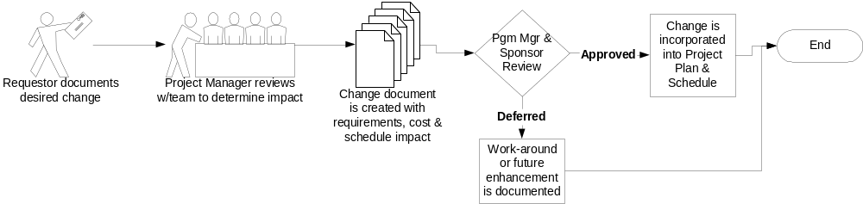
Change Control Process
Change Control is the process for controlling and coordinating all change administration activities impacting the project. The change control process determines if and when a change request will be performed by analyzing all functions impacted by the change.

Slide 14
Project Impacts
Maintenance & Production: (What will it cost later?)
  This section would list bullets about M&P
  Include Ongoing costs
  Provide information regarding resources, hardware, software, 3rd party, etc.
Dependencies or Related Projects: Is your project dependent on or related to another initiative or is one dependent on or related to yours?
  Enter any dependencies and relationships here

Slide 15
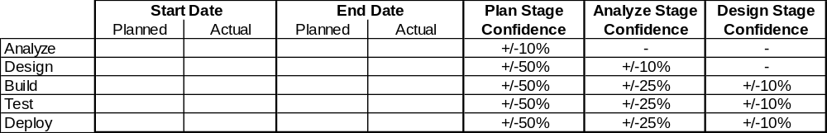
Project Tracking

Slide 16
Project Schedule
<Attach MS Project Schedule – this should be included as part of document when sign-offs are obtained.>

